Slide 1
Mean Shift Clustering

Slide 2
Learning Goals
In this section, we will cover:
- The Mean Shift clustering algorithm
- Algorithm strengths and weaknesses

Slide 3
Mean Shift
A partitioning algorithm that assigns points to nearest cluster centroid.
Centroid:
- point of highest local density
Algorithm ends when all points assigned to a cluster.

Slide 4
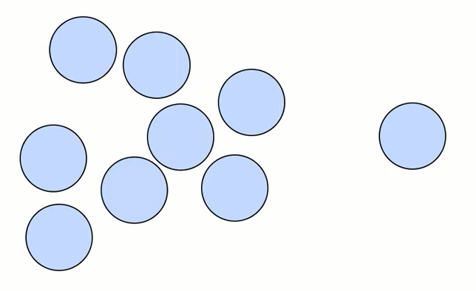
Mean Shift: Local Density
How do you calculate local density?

Slide 5
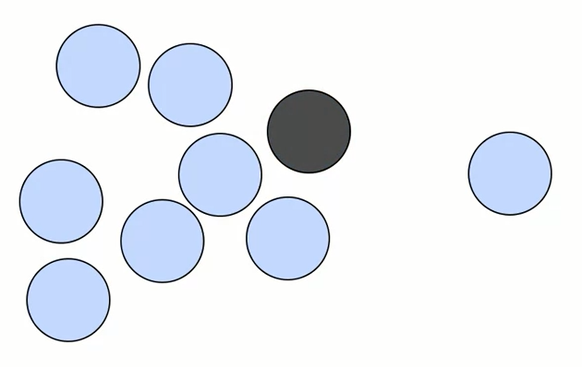
Mean Shift: Local Density
How do you calculate local density?
Evaluate weighted mean around each point.

Slide 6
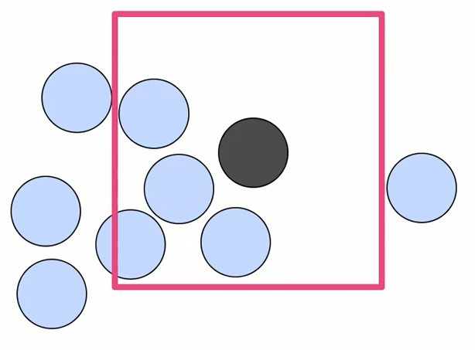
Mean Shift: Local Density
How do you calculate local density?
Evaluate weighted mean around each point.

Slide 7
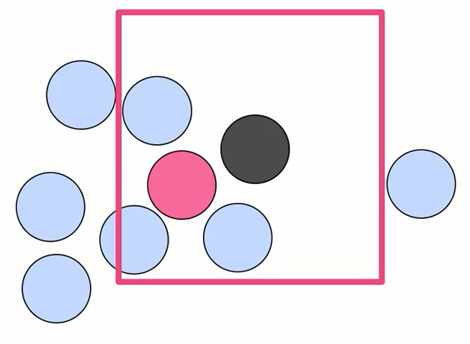
Mean Shift: Local Density
How do you calculate local density?
Evaluate weighted mean around each point.

Slide 8
Mean Shift: The Algorithm
1. Choose a point and window W.
2. Calculate weighted mean in W.
3. Shift centroid of window to new mean.
4. Repeat steps (2) and (3) until convergence (no shift)
i.e. until local density maximum ("mode") is reached.
5. Repeat steps (1-4) for all data points.
6. Data points that lead to same mode are grouped into same cluster.

Slide 9
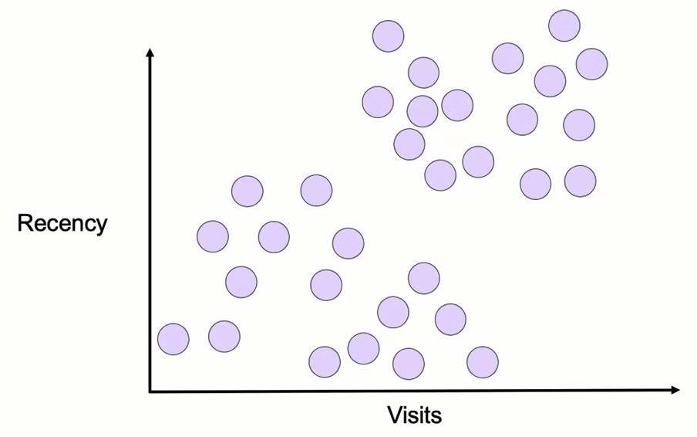
Mean Shift

Slide 10
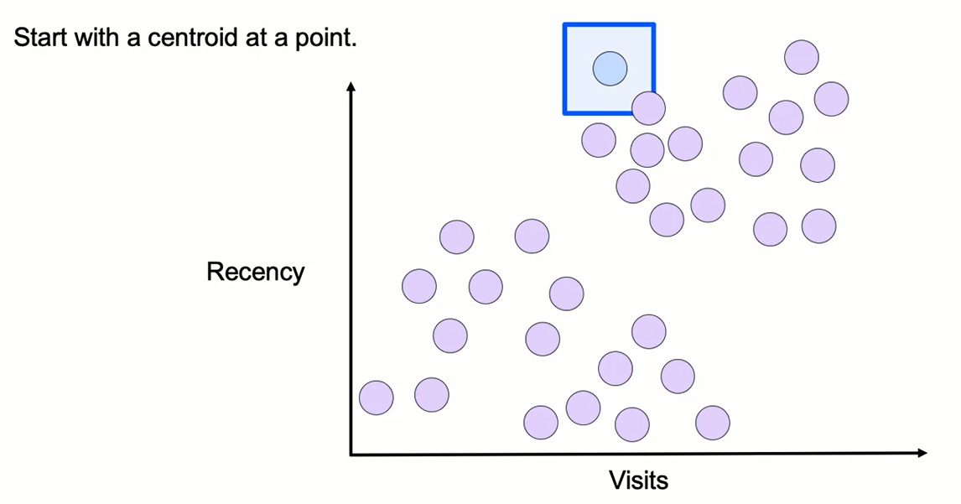
Mean Shift

Slide 11
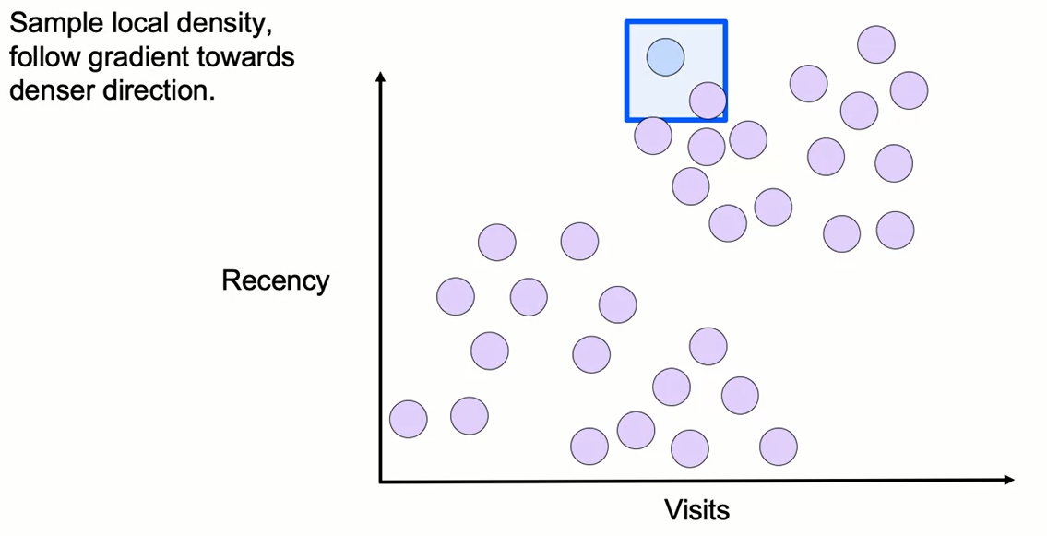
Mean Shift

Slide 12
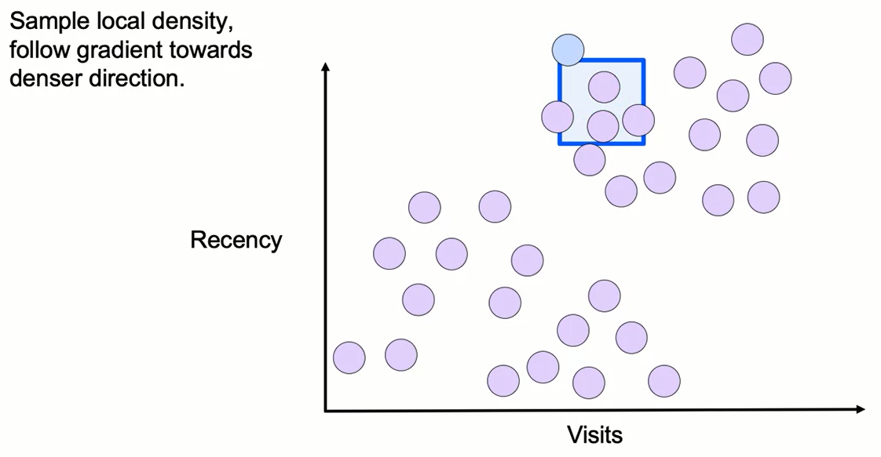
Mean Shift

Slide 13
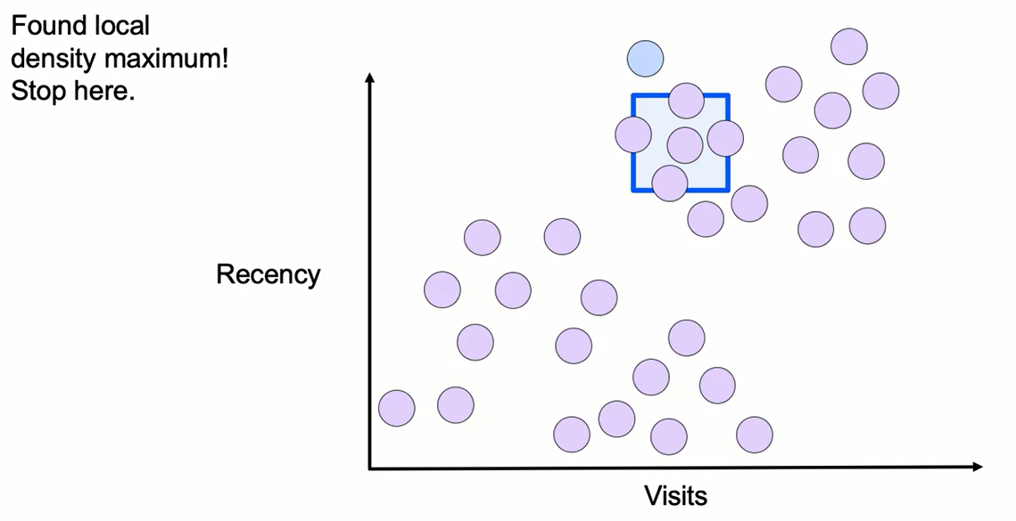
Mean Shift

Slide 14
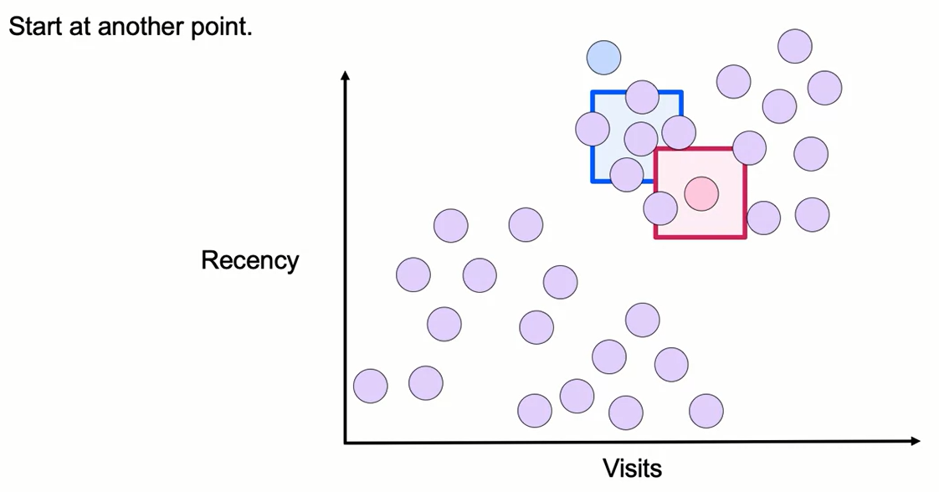
Mean Shift

Slide 15
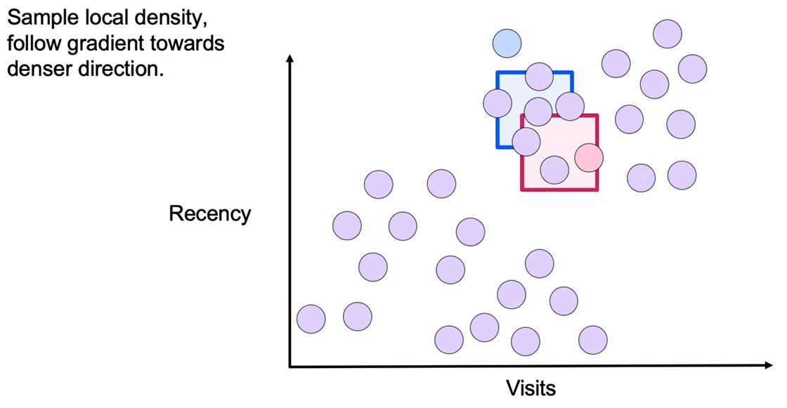
Mean Shift

Slide 16
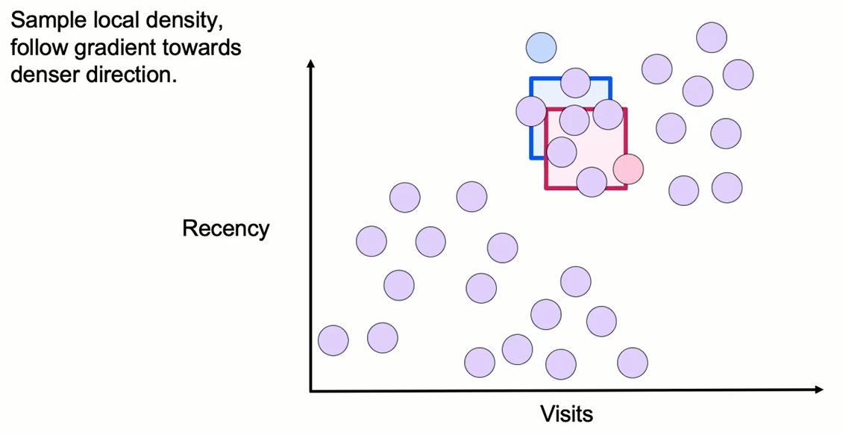
Mean Shift

Slide 17
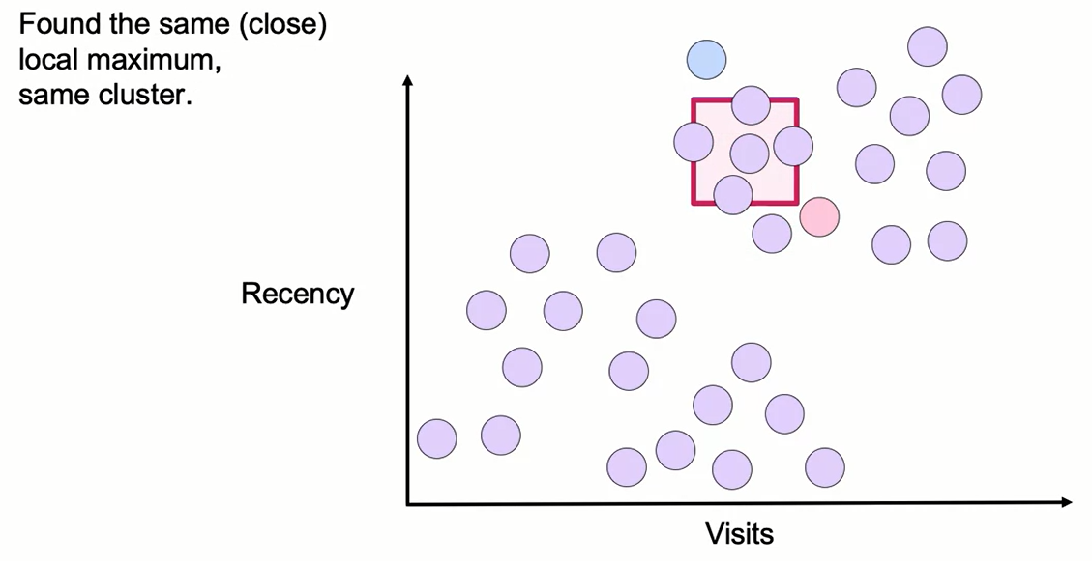
Mean Shift

Slide 18
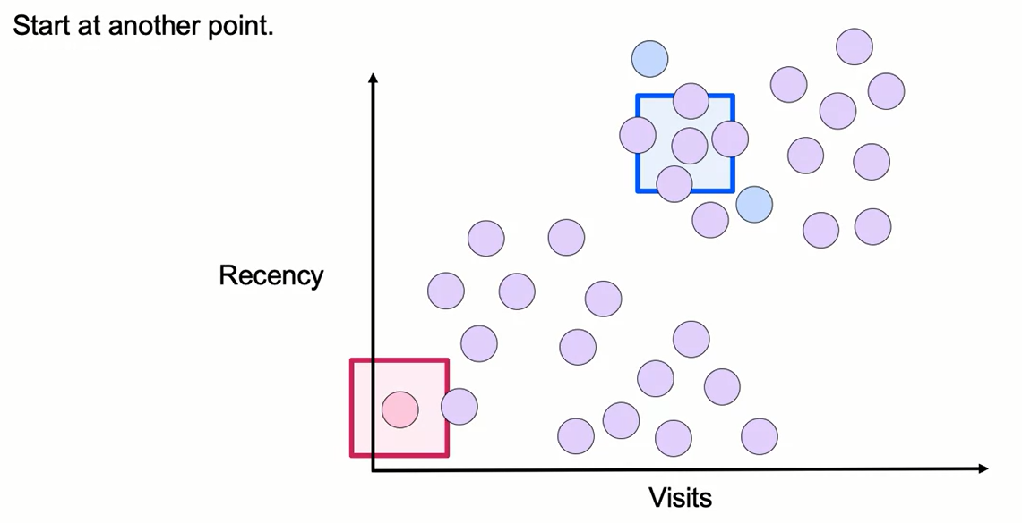
Mean Shift

Slide 19
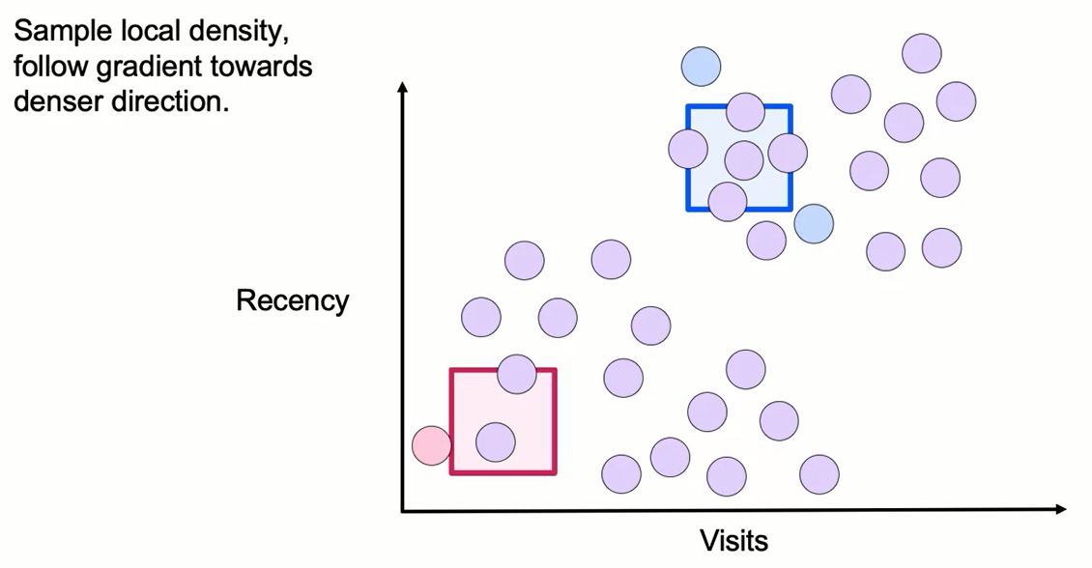
Mean Shift

Slide 20
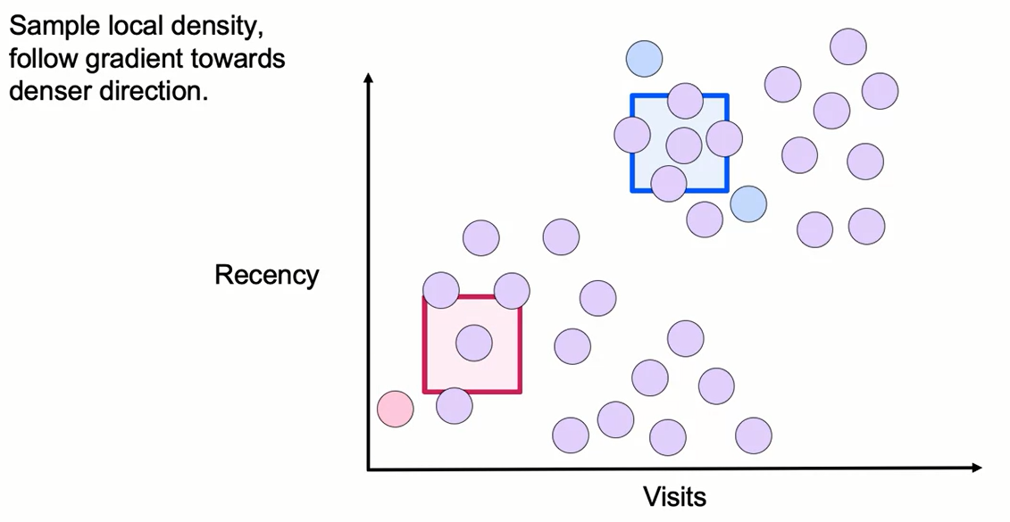
Mean Shift

Slide 21
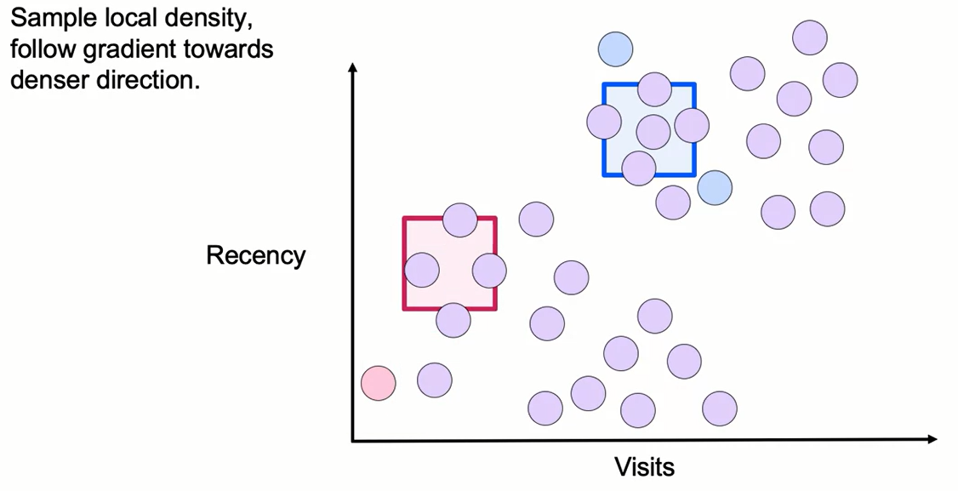
Mean Shift

Slide 22
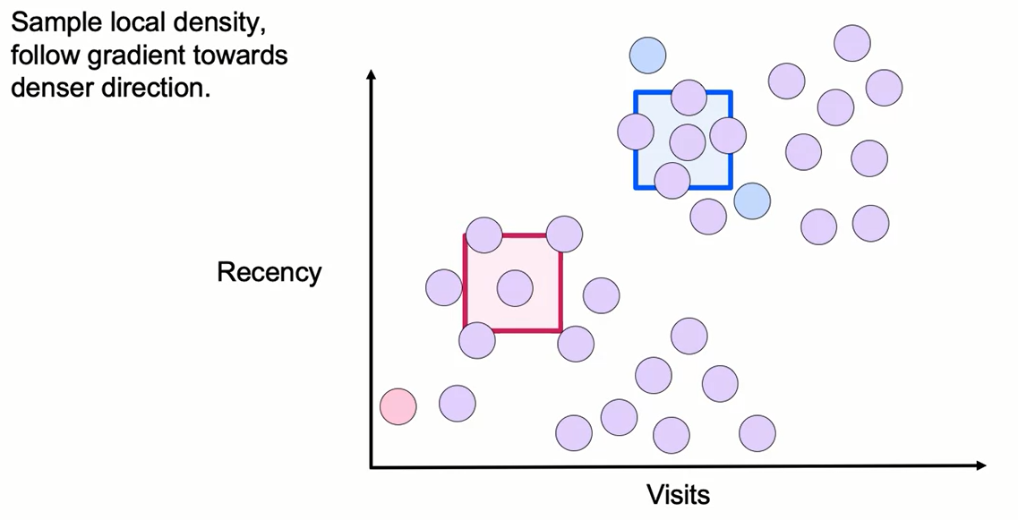
Mean Shift

Slide 23
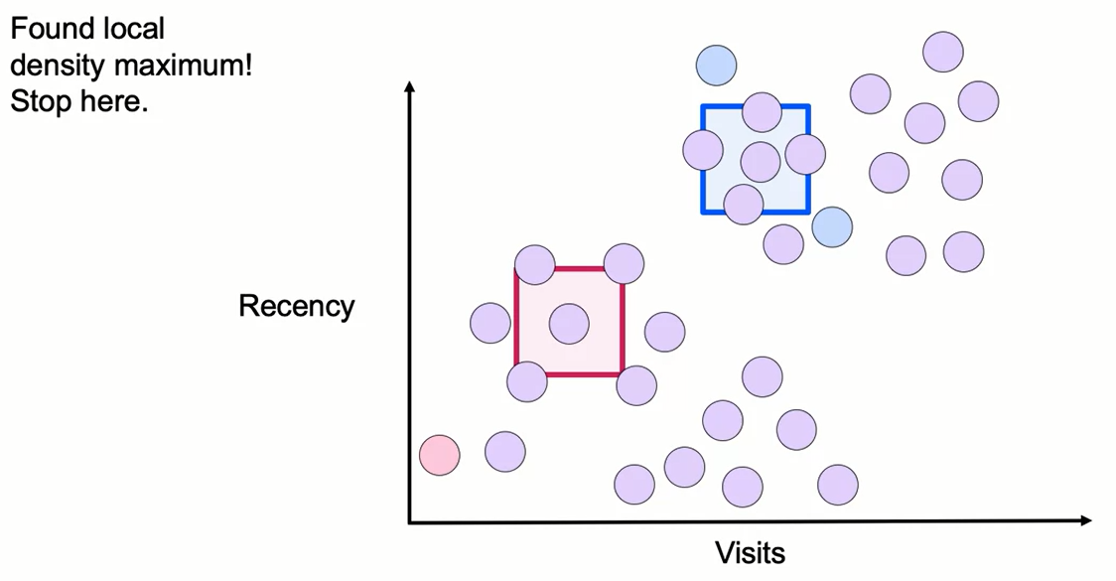
Mean Shift

Slide 24
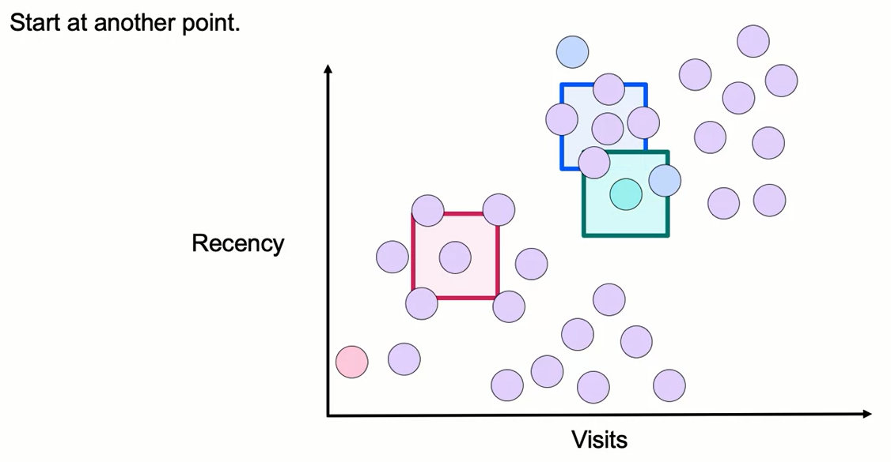
Mean Shift

Slide 25
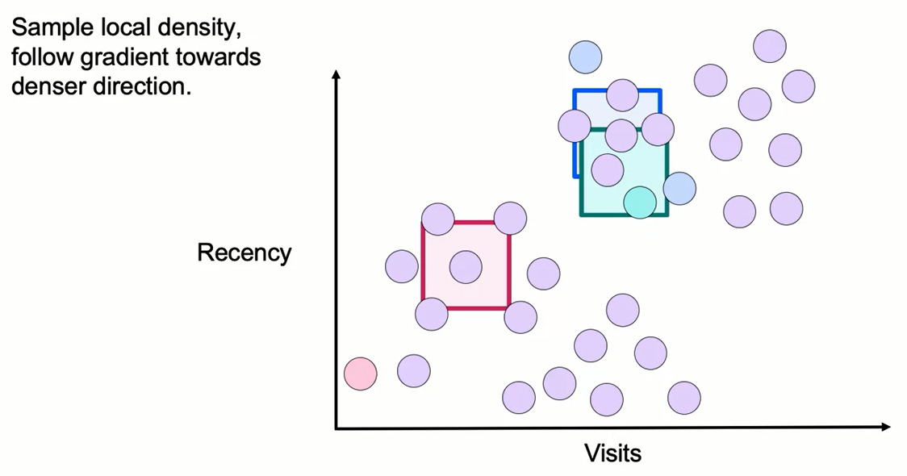
Mean Shift

Slide 26
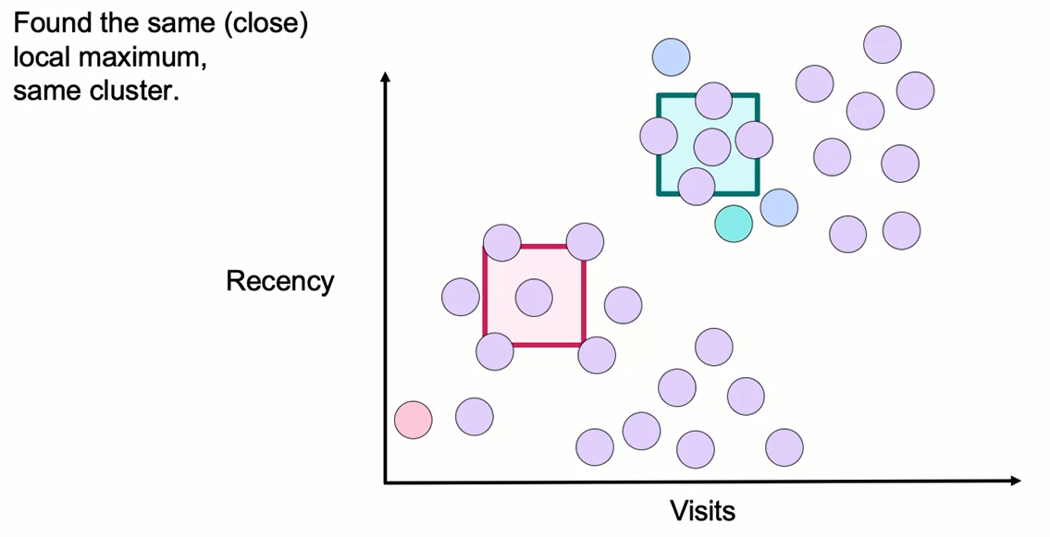
Mean Shift

Slide 27
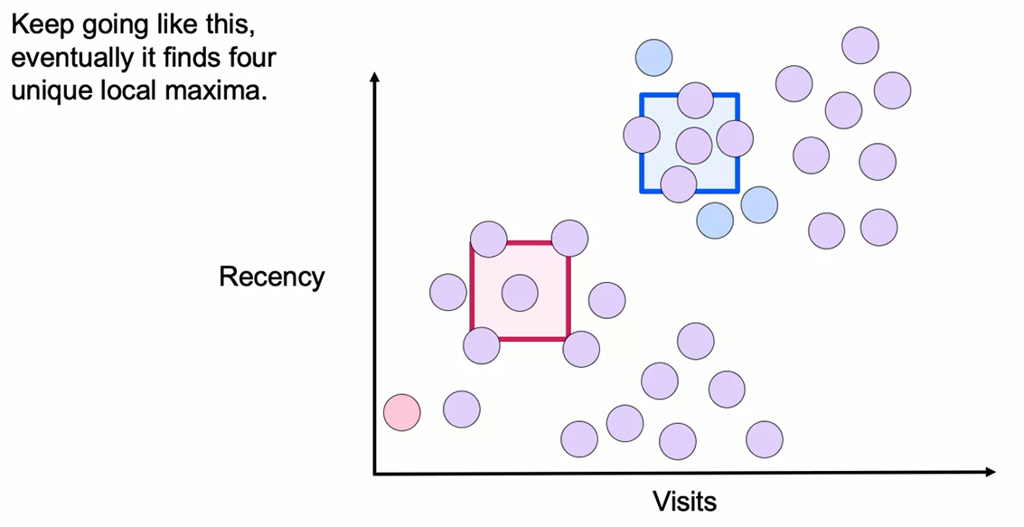
Mean Shift

Slide 28
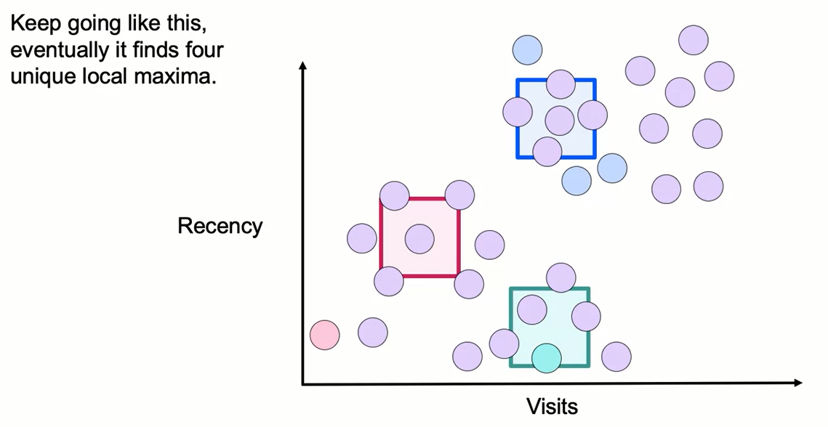
Mean Shift

Slide 29
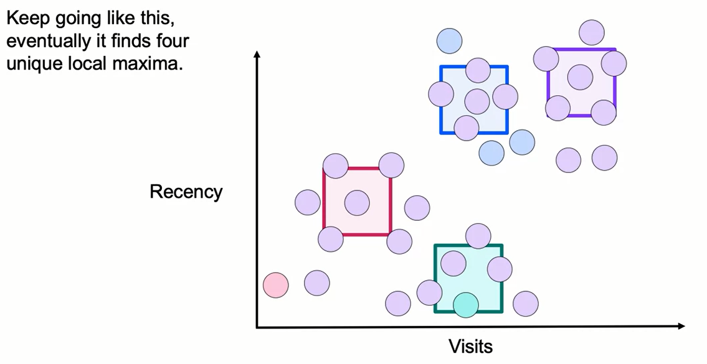
Mean Shift

Slide 30
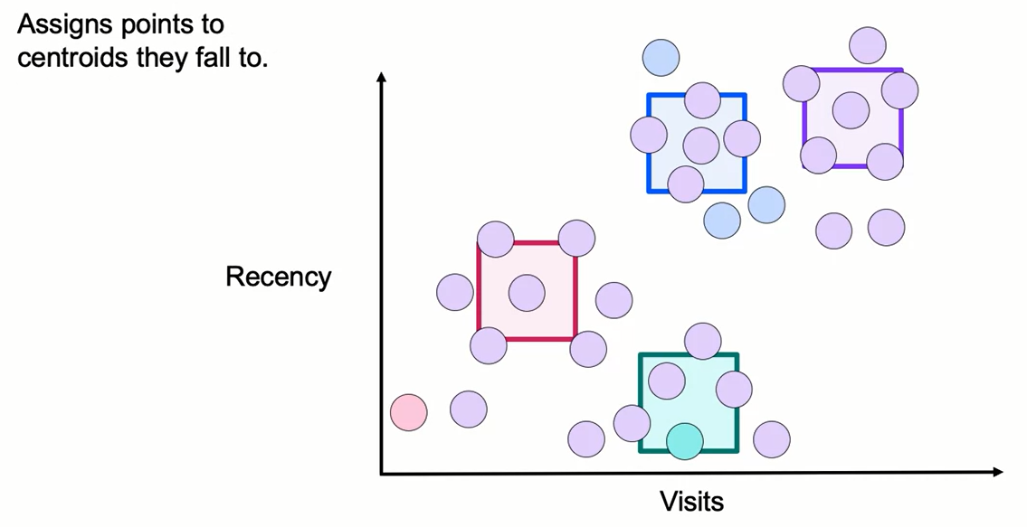
Mean Shift

Slide 31
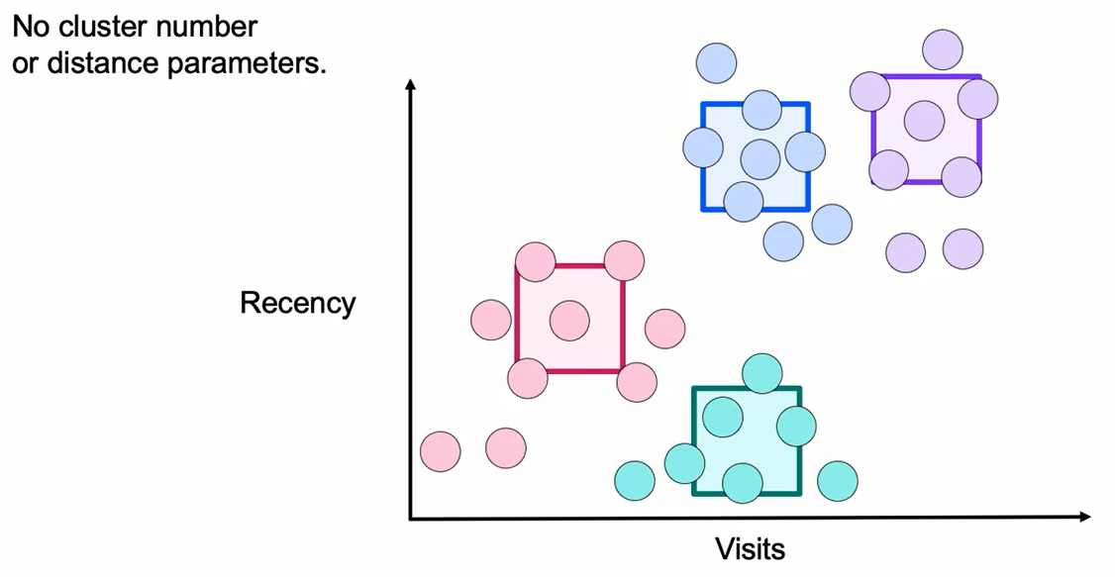
Mean Shift

Slide 32
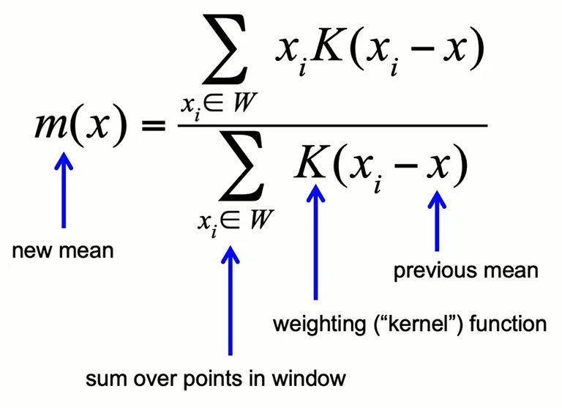
Mean Shift: Weighted Mean

Slide 33
Mean Shift: Strengths vs. Weaknesses
Strengths:
- Model-free: does not assume number or shape of clusters
- Can use just one parameter: window size (bandwidth)
- Robust to outliers
Weaknesses:
- Result depends on window size (bandwidth)
- Selection of window size is not easy
- Can be slow to implement, complexity proportional to mn² (for m iterations and n data points)

Slide 34
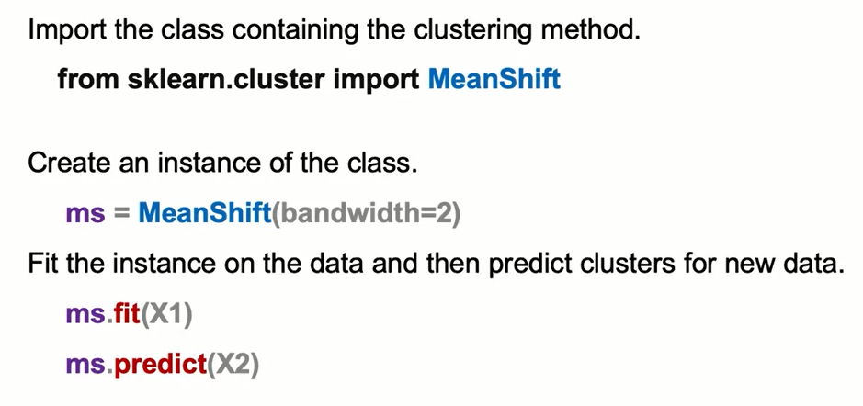
Mean Shift: the Syntax

Slide 35
Learning Recap
In this section, we discussed:
- The Mean Shift clustering algorithm
- Algorithm strengths and weaknesses

